Slide 1


DOL/CEO Worker Leave Model Technical Work Group Meeting
May 10, 2018

Slide 2
Today
I. Introduction
II. Project Goals
III. Technical Work Group Role
IV. Overview of the Model
Current Model Architecture
Key Considerations for Redesign

Slide 3
Today
V. Administrative Cost, Benefits & Financing Module
• Current Model Architecture
• Key Considerations for Redesign
VI. Model Use and Dissemination
• Model Intended Use
• Dissemination Plan
VII. Discussion

Slide 4
DOL Welcome

Slide 5
I. Introductions

Slide 6





Technical Work Group

Slide 7



Technical Work Group

Slide 8









IMPAQ Team
• Aaron Heuser , PhD Mathematician
Sandeep Shetty, PhD Research Associate
Minh Huynh, PhD Project Director
Jessica Smith, MPP Research Associate
• Hautahi Kingi , PhD Research Associate
Mike Trinh, MS Data Scientist
• Luke Patterson, MS Research Associate
Chris Li Zhang , PhD Research Associate
in collaboration with..
Heidi Hartmann, PhD President, IWPR
Jeff Hayes, PhD Program Director, IWPR

Slide 9
II. Project Goals

Slide 10
Current Model
Albelda-Clayton-Matthews-IWPR (ACM-IWPR) model
Uses FMLA Survey and ACS microdata
Built using C++

Slide 11
Desired Project Goals
Change to open-source Python and R from closed source C++
Implement Baseline Validation
Improve performance
Improve ease of use in :
Conducting population analysis
Conducting policy simulation
Conducting counterfactual scenarios
Research Dissemination and Improvement

Slide 12
III. Technical Work Group Role

Slide 13
TWG Role
At Today’s Meeting
Understand Model Architecture
Deliberate on Key Considerations
Provide input on Design, Use, and User Interface
Post-Meeting
Provide follow-up feedback
Provide user feedback (optional)

Slide 14
III. Overview of Model

Slide 15
Model Structure
Part 1
Starts with FMLA 2012 Survey data
Runs 65 regressions on the FMLA Survey data
Obtains probabilities associated with leave taking behavior conditional on some observable x
Uses regression coefficients on a American Community Survey (ACS) sample to predict/impute conditional on observable x in the ACS
TWG Question Any thoughts on this design, method, data?

Slide 16
Model Structure
Part 1 Assumes 6 Classes of Behaviors
j | Reason for taking leave
1 | for own health
2 | for maternity
3 | for caring for new child
4 | for ill child
5 | for ill spouse
6 | for ill relative

Slide 17
Model Structure
Part 1 Assumes 11 Types of Events
k | Event | k | Event
1 | Need Leave | 7 | Get paid while on leave
2 | See a physician | 8 | Get full pay while on leave
3 | Have a hospital visit | 9 | Partial pay while on leave
4 | Take leave when needed | 10 | Would take more leave if available
5 | Would take leave if available | 11 | Would take paid leave if available
6 | Take multiple leave

Slide 18
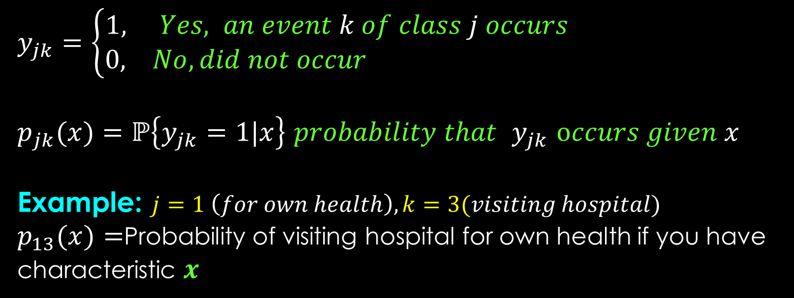
Model Structure
Our Current Model: Possible Outcomes and Probabilities
$y_{jk}=\left\{\begin{aligned}1, Yes, an event k of class j occurs \\ 0, No, did not occur \end{aligned}\right.$
$p_{jk}(x)=ℙ\left\{y_{jk}=1|x\right\}$ $probability that$ $y_{jk}$ $occurs given x$
Example: $j=1 \left(for own health\right), k=3(visiting hospital)$
$p_{13}(x)=$Probability of visiting hospital for own health if you have characteristic $x$

Slide 19
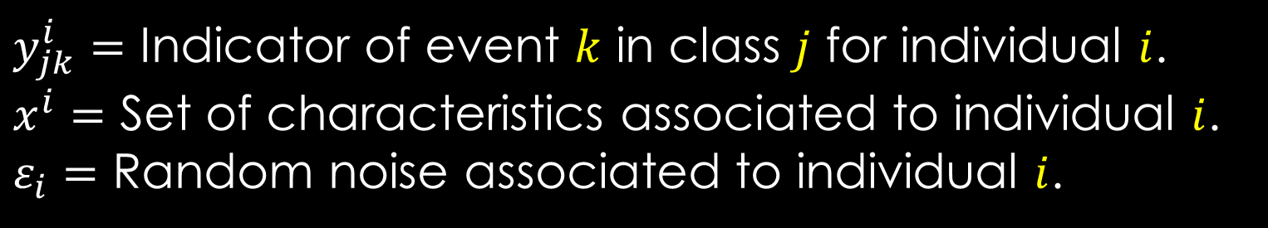

Model Structure
Our Current Model: Summary
$$y_{jk}^{i}=\left\{\begin{aligned}1, f_{jk}\left(x^{i}\right)+ε_{i}>0 \\ 0, f_{jk}\left(x^{i}\right)+ε_{i}≤0\end{aligned}\right.$$
Starts with this
$y_{jk}^{i}=$ Indicator of event $k$ in class $j$ for individual $i$.
$x^{i}=$ Set of characteristics associated to individual $i$.
$ε_{i}=$ Random noise associated to individual $i$.

Slide 20



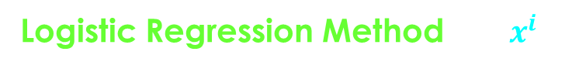

Model Structure
Part 1 Summary
FMLA Survey Data $(y_{jk}^{i} , x^{i})$
National/Local Estimates of $(y_{jk}^{i})$
Logistic Regression Method $f_{jk}(x^{i})$
Apply $β_{jk}$ to ACS Samples $(x^{i})$
Estimated Parameters $β_{jk}$

Slide 21
The Model: Structure
Part 2 Summary
Administrative Benefits and Financing (ABF) module
Uses the probabilities and counts estimated from model Part 1.
Computes various costs associated with a paid leave program.
TWG Question Any conceptual or design issues?

Slide 22
Questions on Current Structure ?

Slide 23
Key Design Considerations

Slide 24
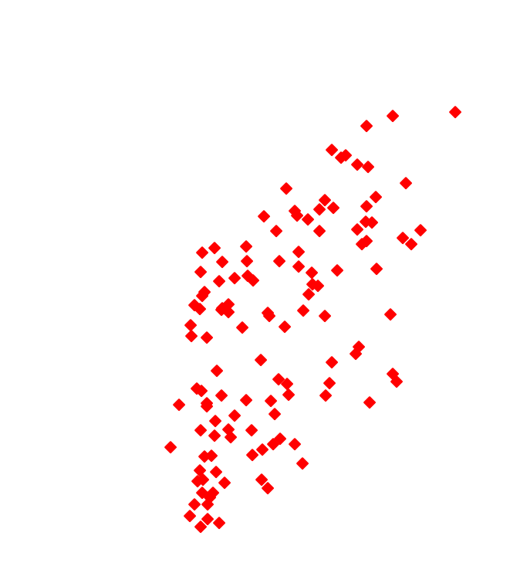
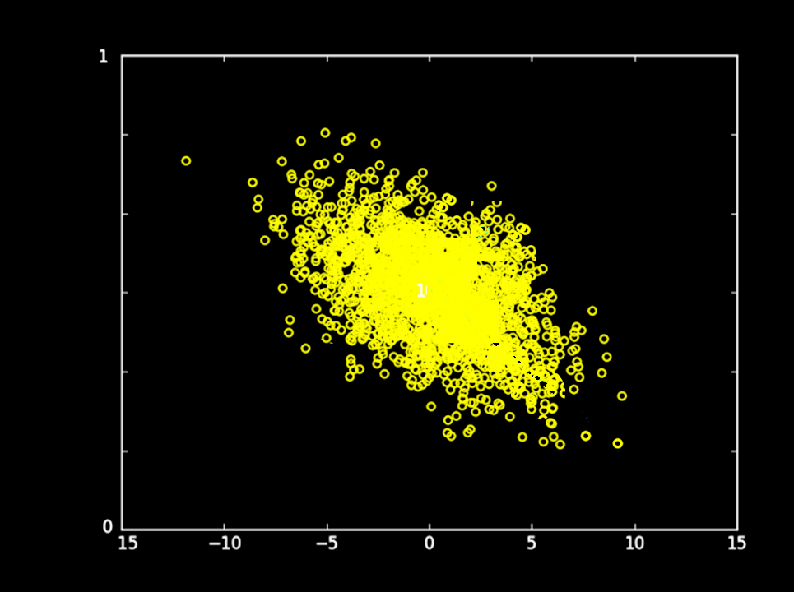
Key Design Considerations
Predicting leave behavior: regression-based methods

Slide 25
Key Design Considerations
Predicting leave behavior: regression-based methods
OLS
LOGIT

Slide 26
Key Design Considerations
Predicting leave behavior: alternatives
Minimum value ellipsoid

Slide 27
Key Design Considerations
Predicting leave behavior: alternatives
Minimum value ellipsoid
Single-index threshold

Slide 28

Key Design Considerations
Predicting leave behavior: alternatives
Minimum value ellipsoid
Projection Pursuit

Slide 29
Key Design Considerations
Predicting leave behavior: alternatives
Minimum value ellipsoid
Single-index threshold
Projection Pursuit

Slide 30
Key Design Considerations
Predicting leave behavior: alternatives
Nearest neighbor
Support Vector Machine
TWG Question Any other family of methods we should consider?

Slide 31
Key Design Consideration
Predicting leave behavior: Summary
Modern imputation methods readily available
Machine Learning Methods readily available
We do NOT choose the options
We let the data tell us which options
How do we do that ?
→Use model validation to determine the most accurate method

Slide 32
Key Design Consideration: Validation
Key Concept
If the model can reliably predict the observed data, then we can be confident in how accurate it is

Slide 33

Key Design Consideration: Validation
Baseline Validation
Simple Validation
Randomly separate data $→$ ½ training, ½ testing.
Training data $→$ Generate regressions.
Regression & testing data $→$ Estimate leave behavior.
Compare estimated & actual behavior $→$ Determine accuracy.
What is wrong with this ?
→Lose half of sample
→Use Cross Validation

Slide 34
Cross Validation
FMLA Survey Data
FMLA Sample A
FMLA Sample B
Validation on 2 groups
Model A
Model B
Average 2-fold Cross-validated performance
How well does Model A predict Sample B ?
How well does Model B predict Sample A ?
Model A Accuracy Rate on B
Model B Accuracy Rate on A

Slide 35
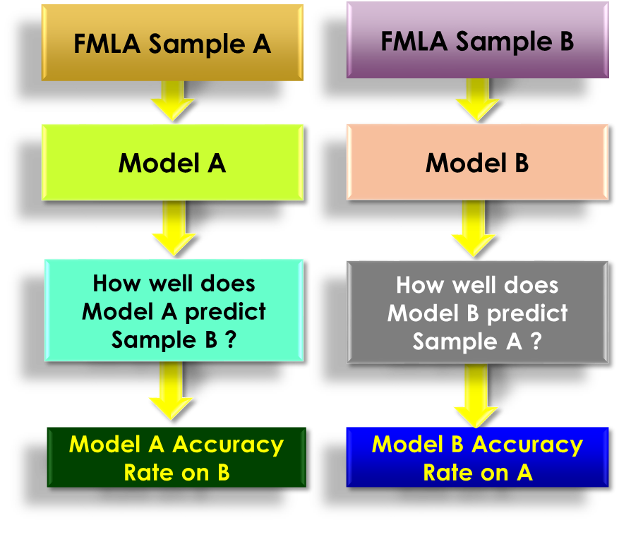
Validation
FMLA Survey Data
Validation on k groups
Average k-fold Cross-validated performance
TWG Question Any other validation methods we should consider?

Slide 36
Why Model Performance Matters

Slide 37
Performance Measure Validity
Why valid performance measures matter
Overestimation and underestimation of leave taking carries through to program cost estimation
Overestimation of costs leads fewer states adopting paid leave programs when it was financially feasible to do so
Underestimation of costs leads states to create paid leave programs with an inadequate financing plan

Slide 38
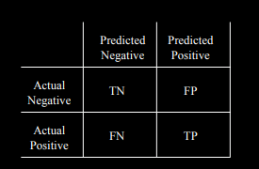


Performance Measure Validity
Need to first ensure measures are not sensitive to prevalence
Assume a Junk predictive model: $f_{jk}\left(x^{i}\right)=0$; predicts no one will take paid leave.
Consider the accuracy performance measure:
$$Accuracy=(TP + TN)/(TP + FP + TN + FN)$$

Slide 39
Performance Measure Validity
Now consider two different populations:
Model is the same, but accuracy is very different!
Population A
100 people, 1 leave taker
Population B
100 people, 50 leave takers
Junk model predicts 0 leave takers
Junk model predicts 0 leave takers
Junk model accuracy: 99%
Junk model accuracy: 50%

Slide 40


Performance Measure Validity
An ideal performance measure will tell us this model is junk regardless of prevalence. Let’s try $Recall=TP/(TP + FN)$
$$TP$$

Slide 41

Performance Measure Validity
An ideal performance measure will tell us this model is junk regardless of prevalence. Let’s try recall. $Recall=TP/(TP + FN)$
This measure more accurately captures the junky model
Population A
100 people, 1 leave taker
Population B
100 people, 50 leave takers
Junk model predicts 0 leave takers
Junk model predicts 0 leave takers
Junk model recall: 0%
Junk model recall: 0%

Slide 42
Performance Measure Validity
To help policymakers decide on a model that reflects their valuation of over- and underestimation risks, we will produce a matrix of models and performance measures with written interpretation of the results.

Slide 43
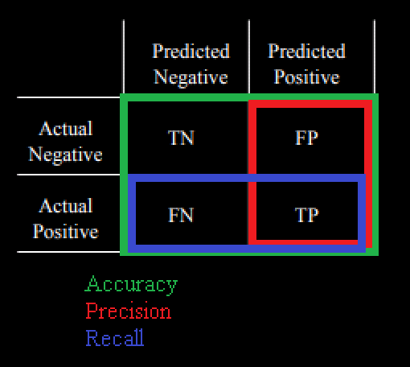
Performance Measure Validity
Model | Accuracy | Recall | Precision | …
Mean Cell | 75% | 90% | 80% | …
Bayesian PCA | 75% | 95% | 70% | …
… | … | … | … | …
Compared to Bayesian PCA, the Mean Cell model has a better precision score. This means it’s less likely to falsely identify a non-leave taker as a leave taker (FP), and subsequently is less likely to overestimate program costs. However, Bayesian PCA has a better recall score. This means it’s less likely to falsely identify a leave taker as a non-leave taker (FN), and subsequently is less likely to underestimate program costs…
TWG Question Any other performance measure we should consider?

Slide 44
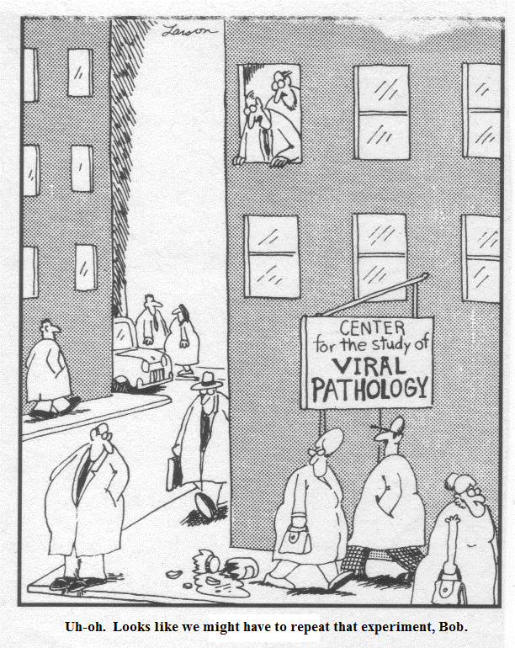
Key Design Consideration
Reproducibility & Repeatability
Repeatability: Repeat of the same experiment under identical conditions & measurement of the within-run precision are both possible.
Reproducibility: Independent reproduction of the original results using a published experimental procedure is possible.
Both may not be possible with web-based source data
TWG Question Any other issues we should consider?

Slide 45
Key Design Consideration
Ease of use
The current model was developed in C++ over many years
• May be inaccessible to those not familiar with C++.
The model size is large (several thousand lines of code)
• May be difficult to use due to learning curve
• May be difficult to customize for specialized use

Slide 46
Key Considerations: Summary
New methods available
Validation methods available
Sampling weights compatibility
Repeatability / reproducibility issues
Ease of use or accessibility issues
Large number of related regressions:
Dependency issues
High likelihood of false discovery

Slide 47
Proposed Approach
Solutions to Key Issues:
Porting to both Python and R
Cross validation
Full documentation
Refined sampling weights
Investigation into alternative simulation/imputation methods.

Slide 48
Methods Options
Conventional Methods
Cell Mean
Random Within Cell Hot Deck
Nearest Neighbor WCHD
k-NN Cell Mean
Fuzzy k-mean
Bayesian Nested HM
Multinomial Regression
Singular Value Decomposition
Bayesian PCA
MICE
Chained Equations with GLMs
Chain Eq. Using Classification
FBJD-DPMM

Slide 49
Methods Options
Machine Leaning Methods
LQDA
Support Vector Machine
Nearest Neighbor
Gaussian Processes
Naïve Bayes
Decision Trees
Random Forest
Multiplayer Perceptron
Stochastic Gradient Descent

Slide 50
Proposed Approach
Questions for TWG:
Have you worked/used any models with similar design?
Could you share any issues you encountered and solutions you developed?
What validation strategies have you used?
Have you used any other model build, test, and validation methods that we should try?

Slide 51
Questions on Key Considerations ?

Slide 52
IV. Administrative Cost, Benefits, and
Financing Module

Slide 53
ABF Module Process Flow
Start with Simulation Output
PROGRAM FUNDING
Estimate Administrative Start-Up & Ongoing Costs
Staffing Costs
Technology infrastructure
Capital (office space, computers)
Public Awareness Campaigns
Paid Leave Benefits
What types of employers/employees contribute?
Taxable wage base?
Simulate Payroll Tax Rate to cover the costs
Leave use &
Paid Leave Benefits
Total Program Costs

Slide 54
Structure of the ABF
Input:
Items that constitute Administrative costs (by user)
Predefined menu based on past feasibility studies that the user can edit
Datasets (ACS, ?) for simulation of tax rates given the covered and eligible subpopulation
Output:
NPV of total costs (= Admin + Benefit) over 5-year horizon
Simulated tax rate to cover total costs
Allow assumptions to manipulate tax rates over 5-year horizon given leave use projections

Slide 55
ABF Design & Build Process
Review existing leave feasibility studies (9 studies)
Interview states with current paid family leave programs to refine design
Input from the TWG & DOL
Refine the ABF module
Code & test

Slide 56
Administrative Costs - Overview
Administrative costs have 2 phases:
Start-up costs (often assumed as Years 1 & 2)
Ongoing costs: Benefits processing cost
Year 1 | Year 2 | Year 3 and forward
Start-Up Program Planning begins IT Implementation begins | Start-Up Program Planning ends IT Implementation ends Hire claims processing staff Hire IT administrative staff | Ongoing Benefits are processed
TWG Question Any other cost items we should consider?

Slide 57
Start-Up Costs Year 1 assumptions
In Year 1, studies reviewed assume:
A group of Program Management and supporting staff
IT staff to build-out the technology platform
One-time IT Hardware costs
One-time facility costs
Overhead costs for workstations, telecommunications equipment, program outreach, etc.
The ABF will account for these different groups for the user to input.
ABF will have guidance notes based on the current programs to help the user with a ballpark estimate

Slide 58
Start-Up Costs Year 2
Year 2 Continues Year 1’s start-up costs but adds additional staff to prepare for program launch.
IT administration/support staff hired on partway through Year 2.
Claims Processing staff hired on partway through Year 2
Additional overhead costs
ABF will allow for the user to enter the above items into the module
ABF will allow export/import of Excel files where the user can make changes to the items and subsequently import into the ABF module

Slide 59
Ongoing Costs
The ongoing costs are mostly personnel costs.
Based on a steady-state of running the program
Expected to reach under 5-years
Most studies assume that claim volume increases a bit over time as the program matures.
User will manipulate the claims growth. ABF will provide default guidance based on existing programs
Staffing numbers depend on the number of claims expected to be filed each year and the time to process a claim.
Feasibility studies have a wide range of FTE to claims ratio. User will have this information to guider her assumptions.

Slide 60
Ongoing Costs of current programs
State Feasibility Study | Total FTE Year 3 | Program Size (claims per year) | Total FTE to Claims Ratio | Total Costs Year 3
Vermont | 36.5 | 15,525 | 1 FTE to 425 claims | $1.9M
Hawaii | 14.6 | 8,970 | 1 FTE to 598 claims | $0.9M
Connecticut (full operating capacity) | 120 | 100,000 | 1 FTE to 833 claims | $18.5M
Washington (year 4 in fiscal note) | 111.4 | 156,000? | 1 FTE to 1,400 | $15.8M
Colorado | 20 | 75,000 | 1 FTE per 3750 claims | $9-$12M
Montgomery County | 70 | 78,000 | 1 FTE per 1,114 claims | No info
Rhode Island (actual program. 2016?) | 58 | 39,863 | 1 staff to 683 claims | No info
New Jersey (actual program 2011) | ? | 30,701 | ? | $6.5M
California (actual Family Leave program SFY16-17) | ? | 260,303 | ? | ?

Slide 61
TWG Questions
Do you know of other similar tools that can do this?
Should we bother modeling Start-Up costs?
How might the model estimate costs for TDI vs non-TDI states?
Would it make sense to allow for a spreadsheet upload for detailed admin cost inputs?
What data sources might be pulled into the admin cost module? (i.e., Federal salary tables?)

Slide 62
Tax–based Financing option
The approaches for financing leave programs:-
Employer only
Employee only
Employer/Employee-based strategy
Allow the user to choose the strategy and define the covered employees or employers
The ABF module will incorporate two scenarios:
flat payroll tax
variable payroll tax

Slide 63
Tax Parameters considered
Who is taxed?
Taxable wage limits
Cap on annual payroll deduction
Flat payroll tax or variable (by income, by year?)
Tax Compliance Rate
Any other to include?
These inputs will feed into the tax simulation exercise

Slide 64
Simulate tax rates
Based on the define tax parameters, the ABF will simulate the applicable tax rate(s)
Obtain relevant datasets
ACS as default; Employer-level recommended data?
Use the total admin cost and benefit costs as the minimum funds required; include the user defined buffer to the funds
Simulate different tax rates and report on the fund adequacy over the 5-year horizon
Generate report using different growth rates in claims, compliance.
TWG Question: Anything else we should consider?

Slide 65
TWG Questions on Tax Modeling
Suggestions on tax simulation approach?
Any other similar tools that we can refer to?
What data sources might we use for wage distributions?
Should we provide the user information on caps on taxable wages for taxes by state?
Any overall suggestions, inputs or recommendations to consider

Slide 66
Tax Regimes of Existing Programs
State (Actual Programs) | Enacted/ Effective | Financing | Built from existing TDI programs
California | 2002/2004 | Employees pay (0.9% of State Disability Insurance taxable wage). Taxable wage ceiling = $114,967 in 2018. | Yes
New Jersey | 2008/2009 | Employees pay (0.1% of taxable wage) | Yes
Rhode Island | 2013/2014 | Employees pay (1.2% up to $66,300 wage base) | Yes
New York | 2016/2018 | Employees pay (0.126% of weekly wage, capped at $85.46 per year) | Yes
Washington | 2017/2019 (premiums collected). Benefits issued in 2020. | Employees (63%)/Employers (37%): 0.4 percent up to the social security cap of $127,200 for each employee | No
District of Columbia | 2017/2020 | Employer pays (0.62% of wages) | No
Sources:
http://www.nationalpartnership.org/research-library/work-family/paid-leave/state-paid-family-leave-laws.pdf
https://www.ny.gov/programs/new-york-state-paid-family-leave
https://esd.wa.gov/paid-family-medical-leave

Slide 67
Questions on ABF Module ?

Slide 68
V. Model Use and Dissemination Plan

Slide 69
Model Use and Dissemination
Intended Use:
Population Analysis
Policy Simulation
Counterfactual simulation
Sandbox Use
Other use?

Slide 70
Model Use and Dissemination
Dissemination Steps:
STEP 1 Baseline measure of current use
• Conduct Citations Search
• Build web-scraper : targeted websites to see who is using the model, posting links to it, or publishing reports, commentaries, or blogs
• Conduct Google Trends Search: who is searching for worker leave model or IWPR model.
• Examine Social Media data: using API (Twitter, tec..), see who is mentioning
STEP 2 Use Findings in STEP 1 to design dissemination plan
STEP 3 Repeat STEP 1 after appropriate time has elapsed

Slide 71
TWG Questions Model Use and Dissemination
Model Use
• Have you built or used similar tools for public release?
• Do you have thoughts on how this model can be most useful ?
Dissemination Strategy
• Have you built and disseminated similar models ?
• Could you share some experience ?

Slide 72
VI. Discussion

Slide 73
TWG Members Input Requested
Have we missed any key issues ?
Have we missed any alternative simulation methods ?
Do you have thoughts on weighting scheme?
Do you have thoughts on the ABF Module ?
Do you have thoughts on validation approach?
Do you have comments on Use & Dissemination Plan ?

Slide 74
TWG Input Requested for ABF Module
Practicality of the Administrative costs component
Large input requirements for estimating administrative costs for the user. Is this an issue?
Substitutable with Excel ?
Any suggestions to make this module more useful?
Simulation of payroll taxes
Are there other applicable datasets ?
Any recommendation on other simulation exercises?
Inputs or suggestions on additional useful features

Slide 75
Final Thoughts

Slide 76
Appendix
Simulation Methods: Cell Mean (CM)
Key Concept:
FMLA $→$ Partition according to similar characteristics.
ACS $→$ Partition in a similar manner.
Leave taking behavior for ACS estimated by mean of corresponding group in FMLA.

Slide 77
Appendix
Simulation Methods: Cell Mean (CM)
Example:
 |  |  | Leave Characteristics |  | Auxiliary Data (Z)
Cell | Individual | Survey | Count | Duration | Age | Education | Gender | Experience
Y1 | 1 | FMLA | 2 | 12 | 26 | 12 | M | 4
Y2 | 2 | FMLA | 3 | 14 | 23 | 16 | F | 1
Y2 | 3 | FMLA | 5 | 13 | 22 | 16 | F | 1
O1 | 4 | FMLA | 1 | 20 | 55 | 18 | M | 30
O1 | 5 | FMLA | 1 | 30 | 48 | 22 | M | 20
Y3 | 1 | ACS |  |  | 22 | 16 | F | 1
Y3 | 2 | ACS |  |  | 28 | 18 | F | 4
Y4 | 3 | ACS |  |  | 23 | 18 | M | 1

Slide 78
Appendix
Simulation Methods: Cell Mean (CM)
Example:
 |  |  | Leave Characteristics |  | Auxiliary Data (Z)
Cell | Individual | Survey | Count | Duration | Age | Education | Gender | Experience
Y1 | 1 | FMLA | 2 | 12 | 26 | 12 | M | 4
Y2 | 2 | FMLA | 3 | 14 | 23 | 16 | F | 1
Y2 | 3 | FMLA | 5 | 13 | 22 | 16 | F | 1
O1 | 4 | FMLA | 1 | 20 | 55 | 18 | M | 30
O1 | 5 | FMLA | 1 | 30 | 48 | 22 | M | 20
Y3 | 1 | ACS | 4 | 13.5 | 22 | 16 | F | 1
Y3 | 2 | ACS | 4 | 13.5 | 28 | 18 | F | 4
Y4 | 3 | ACS |  |  | 23 | 18 | M | 1

Slide 79
Appendix
Simulation Methods: Cell Mean (CM)
Advantages:
Allows for continuous variables to be imputed.
Very fast.
Minimal computational requirements.
Disadvantages:
Attenuation effect.
Imposed independence.
Imposed dependence.

Slide 80
Appendix
Simulation Methods: Random Within Cell Hot-Deck
Key Concept:
FMLA $→$ Partition according to similar characteristics.
ACS $→$ Partition in a similar manner.
Leave taking behavior for ACS estimated by random selection of individual of corresponding group in FMLA.

Slide 81
Appendix
Simulation Methods: Random Within Cell Hot-Deck
Example:
 |  |  | Leave Characteristics |  | Auxiliary Data (Z)
Cell | Individual | Survey | Count | Duration | Age | Education | Gender | Experience
Y1 | 1 | FMLA | 2 | 12 | 26 | 12 | M | 4
Y2 | 2 | FMLA | 3 | 14 | 23 | 16 | F | 1
Y2 | 3 | FMLA | 5 | 13 | 22 | 16 | F | 1
O1 | 4 | FMLA | 1 | 20 | 55 | 18 | M | 30
O1 | 5 | FMLA | 1 | 30 | 48 | 22 | M | 20
Y3 | 1 | ACS |  |  | 22 | 16 | F | 1
Y3 | 2 | ACS |  |  | 28 | 18 | F | 4
Y4 | 3 | ACS |  |  | 23 | 18 | M | 1

Slide 82
Appendix
Simulation Methods: Random Within Cell Hot-Deck
Example:
 |  |  | Leave Characteristics |  | Auxiliary Data (Z)
Cell | Individual | Survey | Count | Duration | Age | Education | Gender | Experience
Y1 | 1 | FMLA | 2 | 12 | 26 | 12 | M | 4
Y2 | 2 | FMLA | 3 | 14 | 23 | 16 | F | 1
Y2 | 3 | FMLA | 5 | 13 | 22 | 16 | F | 1
O1 | 4 | FMLA | 1 | 20 | 55 | 18 | M | 30
O1 | 5 | FMLA | 1 | 30 | 48 | 22 | M | 20
Y3 | 1 | ACS | 3 | 14 | 22 | 16 | F | 1
Y3 | 2 | ACS |  |  | 28 | 18 | F | 4
Y4 | 3 | ACS |  |  | 23 | 18 | M | 1

Slide 83
Appendix
Simulation Methods: Random Within Cell Hot-Deck
Advantages:
Allows for continuous variables to be imputed.
Very fast.
Can alleviate the issues of attenuation and imposed dependence.
Disadvantages:
The group partitioning can result in a silo effect.

Slide 84
Appendix
Simulation Methods: Nearest Neighbor Within Cell Hot-Deck
Key Concept:
FMLA $→$ Partition according to similar characteristics.
ACS $→$ Partition in a similar manner.
Defined metric $→$ Gives “distance” between profiles.
Leave taking behavior for ACS estimated nearest individual of corresponding group in FMLA.

Slide 85
Appendix
Simulation Methods: Nearest Neighbor Within Cell Hot-Deck
Example:
 |  |  | Leave Characteristics |  | Auxiliary Data (Z)
Cell | Individual | Survey | Count | Duration | Age | Education | Gender | Experience
Y1 | 1 | FMLA | 2 | 12 | 26 | 12 | M | 4
Y2 | 2 | FMLA | 3 | 14 | 23 | 16 | F | 1
Y2 | 3 | FMLA | 5 | 13 | 22 | 16 | F | 1
O1 | 4 | FMLA | 1 | 20 | 55 | 18 | M | 30
O1 | 5 | FMLA | 1 | 30 | 48 | 22 | M | 20
Y3 | 1 | ACS |  |  | 22 | 16 | F | 1
Y3 | 2 | ACS |  |  | 28 | 18 | F | 4
Y4 | 3 | ACS |  |  | 23 | 18 | M | 1

Slide 86
Appendix
Simulation Methods: Nearest Neighbor Within Cell Hot-Deck
Example:
 |  |  | Leave Characteristics |  | Auxiliary Data (Z)
Cell | Individual | Survey | Count | Duration | Age | Education | Gender | Experience
Y1 | 1 | FMLA | 2 | 12 | 26 | 12 | M | 4
Y2 | 2 | FMLA | 3 | 14 | 23 | 16 | F | 1
Y2 | 3 | FMLA | 5 | 13 | 22 | 16 | F | 1
O1 | 4 | FMLA | 1 | 20 | 55 | 18 | M | 30
O1 | 5 | FMLA | 1 | 30 | 48 | 22 | M | 20
Y3 | 1 | ACS | 5 | 13 | 22 | 16 | F | 1
Y3 | 2 | ACS |  |  | 28 | 18 | F | 4
Y4 | 3 | ACS |  |  | 23 | 18 | M | 1

Slide 87
Appendix
Simulation Methods: Nearest Neighbor Within Cell Hot-Deck
Advantages:
Alleviates silo effect.
Lower likelihood of too many observations imputed from the same FMLA profile.
Disadvantages:
Dependent upon the number of neighbors.
Dependent upon the defined distance function.

Slide 88
Appendix
Simulation Methods: k-Nearest Neighbors Cell Mean
Key Concept:
Defined metric $→$ Gives “distance” between profiles.
Given ACS profile $→$ Find k nearest FMLA profiles.
Leave taking behavior $→$ Mean of k nearest profiles.

Slide 89
Appendix
Simulation Methods: k-Nearest Neighbors Cell Mean
Example:
 |  |  | Leave Characteristics |  | Auxiliary Data (Z)
Cell | Individual | Survey | Count | Duration | Age | Education | Gender | Experience
Y1 | 1 | FMLA | 2 | 12 | 26 | 12 | M | 4
Y2 | 2 | FMLA | 3 | 14 | 23 | 16 | F | 1
Y2 | 3 | FMLA | 5 | 13 | 22 | 16 | F | 1
Y2 | 4 | FMLA | 1 | 20 | 22 | 16 | F | 1
O1 | 5 | FMLA | 1 | 30 | 48 | 22 | M | 20
Y3 | 1 | ACS |  |  | 22 | 16 | F | 1
Y3 | 2 | ACS |  |  | 28 | 18 | F | 4
Y4 | 3 | ACS |  |  | 23 | 18 | M | 1

Slide 90
Appendix
Simulation Methods: k-Nearest Neighbors Cell Mean
Example:
 |  |  | Leave Characteristics |  | Auxiliary Data (Z)
Cell | Individual | Survey | Count | Duration | Age | Education | Gender | Experience
Y1 | 1 | FMLA | 2 | 12 | 26 | 12 | M | 4
Y2 | 2 | FMLA | 3 | 14 | 23 | 16 | F | 1
Y2 | 3 | FMLA | 5 | 13 | 22 | 16 | F | 1
Y2 | 4 | FMLA | 1 | 20 | 22 | 16 | F | 1
O1 | 5 | FMLA | 1 | 30 | 48 | 22 | M | 20
Y3 | 1 | ACS | 3 | 16.5 | 22 | 16 | F | 1
Y3 | 2 | ACS |  |  | 28 | 18 | F | 4
Y4 | 3 | ACS |  |  | 23 | 18 | M | 1

Slide 91
Appendix
Simulation Methods: k-Nearest Neighbors Cell Mean
Advantages:
Imputation is based on any set of $k$ individuals, defined by a similarity metric.
No attenuation effect.
Disadvantages:
Only accounts for rank of distance, and not magnitude, which allows for the nearest neighbors to be distant in some cases.

Slide 92
Appendix
Simulation Methods: Fuzzy k-means (FKM)
Key Concept:
FMLA $→$ Partition according to similar characteristics, allowing for individuals to have “partial” membership to multiple groups.
ACS $→$ Partition in a similar manner.
Defined metric $→$ Gives “distance” between profiles.
Leave taking behavior $→$ Mean of k nearest profiles in corresponding group.

Slide 93
Appendix
Simulation Methods: Fuzzy k-means (FKM)
Advantages:
Partial membership of groups alleviates silo effect.
Imputed value is related to behavior of entire population.
Disadvantages:
Very subjective to the manner in which groups are partitioned.
Large sample size can be computationally expensive.

Slide 94
Appendix
Simulation Methods: Bayesian Nested Hierarchical Models
Key Concept:
Current logistic regression method ignores “cross-group” correlations.
Example: Length of parent-illness leave for males with children should tell us something about the length of children-illness leave for males with children.
By considering these cross-group correlations, better estimates can be obtained.

Slide 95
Appendix
Simulation Methods: Bayesian Nested Hierarchical Models
Advantages:
Information from correlations improves upon estimation accuracy.
Disadvantages:
Method is subjective to groupings and to modeling approach.
Method can be computationally expensive.

Slide 96
Appendix
Simulation Methods: Multinomial Regression
Key Concept:
Current logistic regression method assumes independence of possible outcomes.
If the probability that regression $i$ gives misleading information is $q_{i}$, then the probability of at least one regression giving misleading information is
$$Q_{n}=1−\prod_{i=1}^{n}{{(1−q}_{i})}.$$

Slide 97
Appendix
Simulation Methods: Multinomial Regression
Key Concept:
Since $q_{i}∈\left(0,1\right)$, $\lim_{n→∞}{Q_{n}}=1$. That is, a large number of regressions implies a high likelihood of bad results.
Instead of modeling $n$ regressions, we can consider one regression with $n$ possible outcomes.

Slide 98
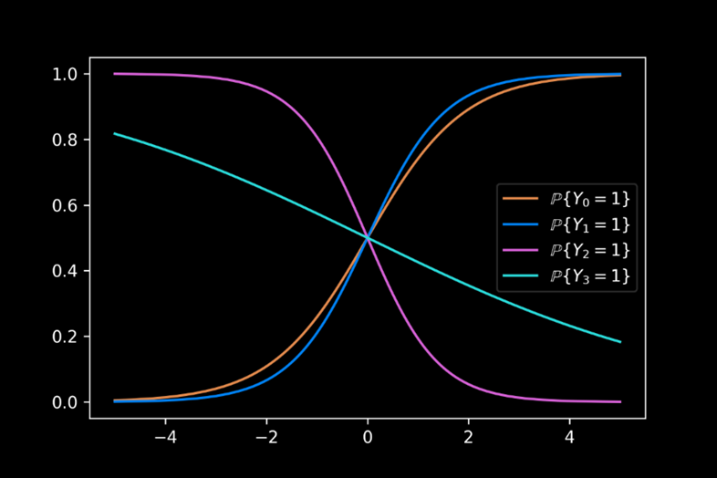
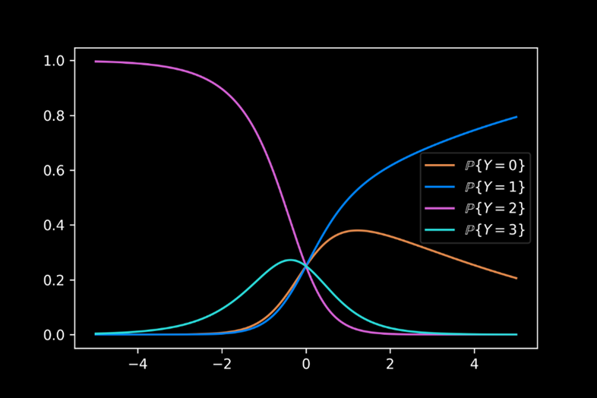
Appendix
Simulation Methods: Multinomial Regression
Example (4 logistic regressions vs multinomial regression):

Slide 99
Appendix
Simulation Methods: Multinomial Regression
Advantages:
Dependence of outcomes is accounted for.
The likelihood of misleading information is significantly reduced.
The model is similar to the original methods, and is easily understood.
Disadvantages:
Determining proper covariates for all possible outcomes is difficult.

Slide 100
Appendix
Simulation Methods: Singular Value Decomposition (SVD)
Key Concept:
Utilize principal component analysis (PCA) via SVD to generate a complete data matrix with imputed elements replacing missing data.
Construction is based upon the principal components that represent key factors in the data.

Slide 101
Appendix
Simulation Methods: Singular Value Decomposition (SVD)
PCA using SVD:
We begin with a data matrix $X$ with $n$ rows and $p$ columns.
Determine the $s$ principal components $(s≤p)$:
Generate the SVD of $X=UΛV^{T}$.
Take the $s$ largest values on the diagonal of $Λ$ to generate the reduced rank diagonal matrix $\hat{Λ}$. Similarly define $\hat{U}$ and $\hat{V}$ to obtain $\hat{X}=\hat{U}\hat{Λ}{\hat{V}}^{T}$.

Slide 102
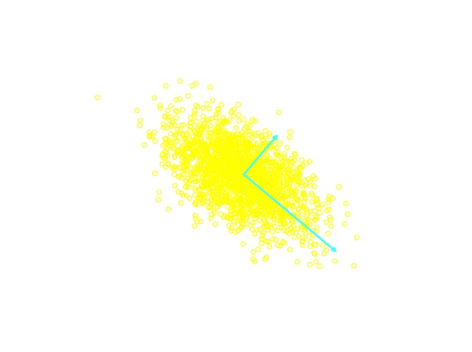
Appendix
Simulation Methods: Singular Value Decomposition (SVD)
PCA Example:
Consider the example with $s=p=2$, with 2000 observations drawn from $N\left(\left(0,0\right),\left(\begin{matrix}1 & 5 \\ −10 & 10\end{matrix}\right)\right)$.
We note that the locations of the PCA vectors are given by $\hat{U}\hat{Λ}$, with the magnitude given by $\hat{V}$.

Slide 103
Appendix
Simulation Methods: Bayesian Principal Component Analysis (BPCA)
Key Concept:
The lack of uncertainty in SVD can be remedied by considering a Bayesian treatment of the imputed data.
This method allows for randomness in each iteration step of the imputation.

Slide 104
Appendix
Simulation Methods: Bayesian Principal Component Analysis (BPCA)
Key Concept:
It is assumed that the data matrix $X=\tilde{X}+E$, where:
$\tilde{X}$ is the signal matrix, estimated by classic PCA.
$E$ is a matrix of random elements, each distributed as $N\left(0, σ^{2}\right)$.
The variance $σ^{2}$ has the least square estimate given by ${\hat{σ}}^{2}=\frac{\sum_{ij}{{\left(x_{ij}−{\hat{x}}_{ij}\right)}^{2}}}{np−\left(p+s\left(n−1+p−s\right)\right)}$, where $x_{ij}$ and ${\hat{x}}_{ij}$ are the respective elements of $X$ and $\hat{X}$.

Slide 105
Appendix
Simulation Methods: Bayesian Principal Component Analysis (BPCA)
Bayesian PCA:
Initialization:
Demean $X$ – Subtract the mean over all non-missing data from each data element.
Estimate $\left({\tilde{X}}^{\left(0\right)},σ^{2,\left(0\right)}\right)=\left(\hat{X},{\hat{σ}}^{2}\right)$, where $\hat{X}$ is the PCA estimate of the demeaned data matrix.

Slide 106
Appendix
Simulation Methods: Bayesian Principal Component Analysis (BPCA)
Bayesian PCA:
Burn In:
This ensures stochastic stationarity of imputation. This is done $K$ times, where $K$ is sufficiently large to achieve stationarity.

Slide 107
Appendix
Simulation Methods: Bayesian Principal Component Analysis (BPCA)
Bayesian PCA:
For each $k=1,…,K$:
I-Step:
Generate $X^{\left(k\right)}={\tilde{X}}^{\left(k−1\right)}+E$.
Restore the mean of $X^{\left(k\right)}$ by adding the mean values subtracted by demeaning.

Slide 108
Appendix
Simulation Methods: Bayesian Principal Component Analysis (BPCA)
Bayesian PCA:
For each $k=1,…,K$:
P-Step:
Demean $X^{\left(k\right)}$.
Compute $\left({\hat{X}}^{\left(k\right)}, {\hat{σ}}^{2, \left(k\right)}\right)$.
Generate new $\tilde{X}$, where each element ${\tilde{x}}_{ij}^{\left(k\right)}$ is drawn from the posterior distribution $N\left({\hat{x}}_{ij}^{\left(k\right)},\frac{{\hat{σ}}^{2,\left(k\right)}}{p}\right)$.

Slide 109
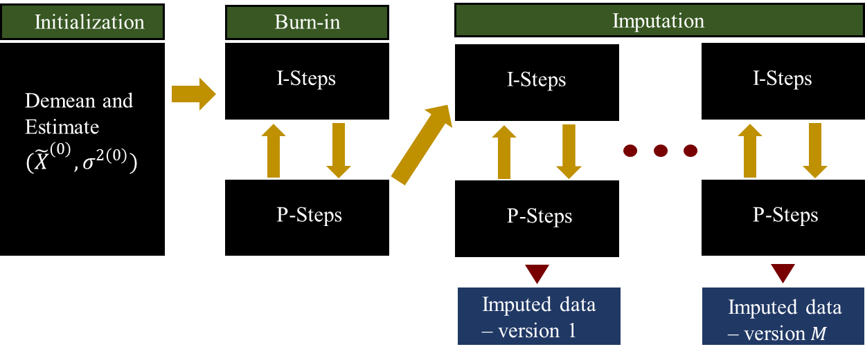
Appendix
Simulation Methods: Bayesian Principal Component Analysis (BPCA)
Example:

Slide 110
Appendix
Simulation Methods: Bayesian Principal Component Analysis (BPCA)
Advantages:
Bayesian PCA can improve upon the standard PCA by accounting for uncertainty in imputation.
Disadvantages:
There is no perfect method for determining $K$, and so, the imputed data may not be stochastically stationary.
Insufficient gap between consecutive versions of imputation can cause dependency between versions.

Slide 111
Appendix
Simulation Methods: Multiple Imputations by Chained Equations (MICE)
Key Concept:
Simultaneously impute multiple variables.
Iteratively consider one variable at a time, using the remaining variables for imputation.
The iteration is stopped when difference in imputed values falls below a set threshold.

Slide 112
Appendix
Simulation Methods: Multiple Imputations by Chained Equations (MICE)
Key Concept:
Initialization:
Begin with simple method (e.g. cell mean) to initialize missing data.
Iteration:
Fix one variable for imputation as missing.
Estimate using regression on remaining variables.
Repeat until the difference in successive values falls below the set threshold.

Slide 113
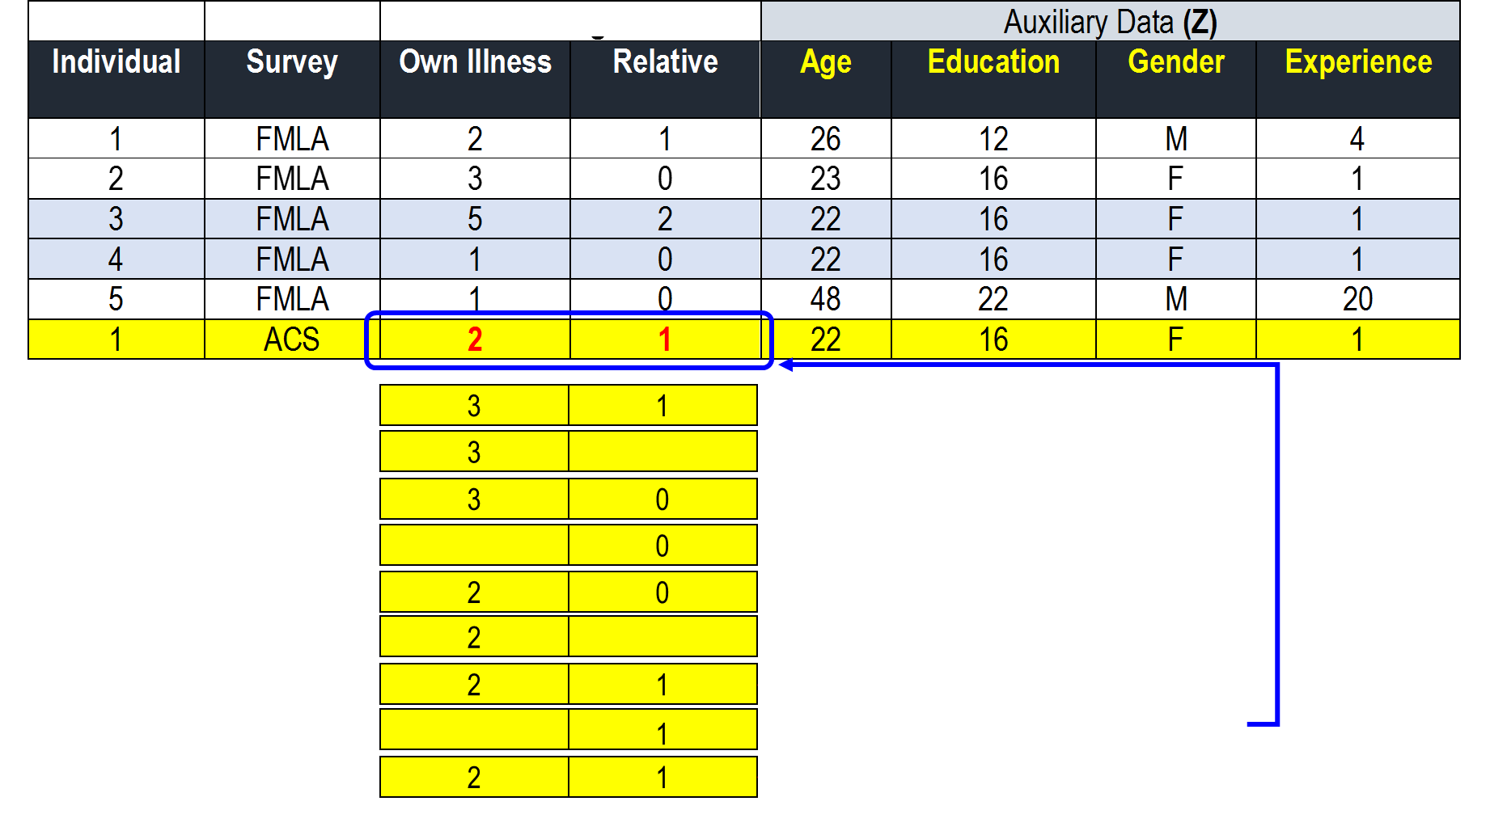
Appendix
Simulation Methods: Multiple Imputations by Chained Equations (MICE)
Example:

Slide 114
Appendix
Simulation Methods: Multiple Imputations by Chained Equations (MICE)
Advantages:
Multiple variables can be imputed simultaneously.
Method relies only on simple imputation methods.
Disadvantages:
Linear regression is restrictive.
Mechanical application may lead to logically inconsistent imputation models.
Time to convergence varies, is generally unknown, and in some cases, can be prohibitively long.

Slide 115
Appendix
Simulation Methods: Chained Equations Using Generalized Linear Models (GLMs)
Key Concept:
The MICE method is restricted to a linear regression, which may not be a proper model for the missing data.
Generalizes the MICE method by allowing for a generalized linear model (GLM).
Such models include ordinary least squares (OLS), log-linear models, and exponential model.

Slide 116
Appendix
Simulation Methods: Chained Equations Using Generalized Linear Models (GLMs)
Advantages:
In addition to those of the general MICE, this method offers better flexibility, which may lead to better simulation performance.
Disadvantages:
With the exception of the model restriction to a linear regression, this method has the same disadvantages as the MICE.

Slide 117
Appendix
Simulation Methods: Chained Equations Using Classification and Regression Trees
Key Concept:
Improve upon the MICE method through the use of regression tress.
The use of regression trees will account for conditional behavior in leave taking that is missed by standard regression.

Slide 118
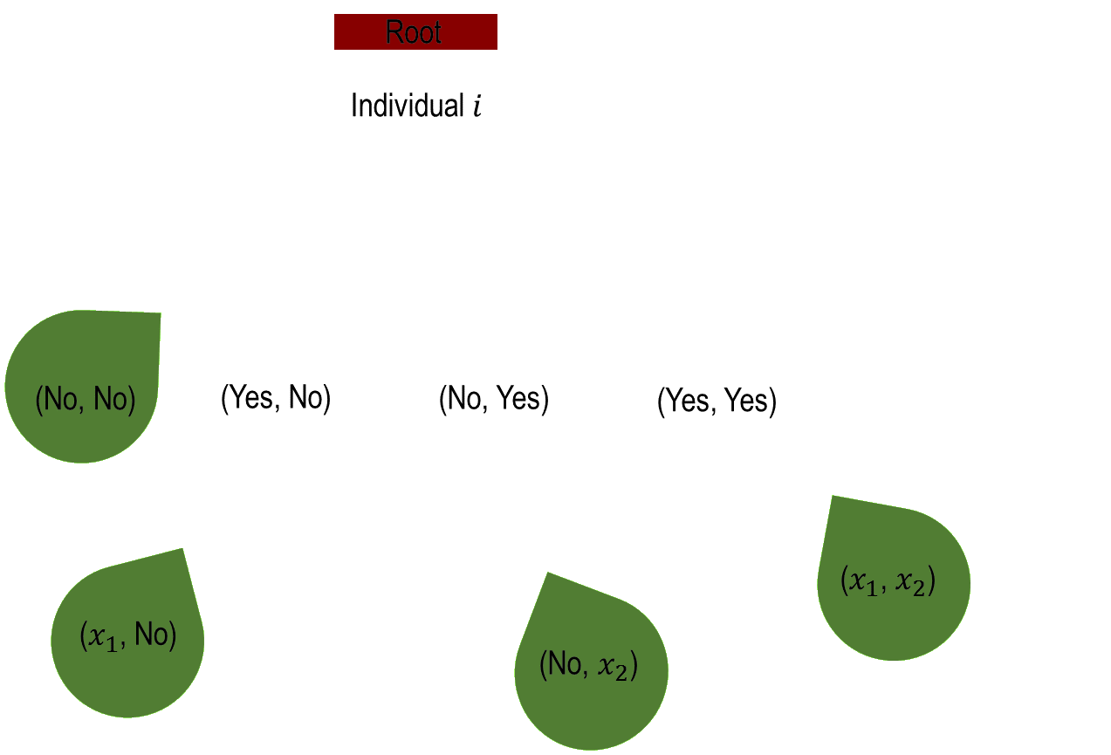
Appendix
Simulation Methods: Chained Equations Using Classification and Regression Trees
Example:

Slide 119
Appendix
Simulation Methods: Chained Equations Using Classification and Regression Trees
Advantages:
In addition to those of the general MICE, this method further considers conditional behavior in leave taking.
Disadvantages:
Risk of excessive complexity of tree structure can result in results that are difficult to determine.

Slide 120
Appendix
Simulation Methods: Fully Bayesian Joint Distribution Based on Dirichlet Process Mixture Models
Key Concept:
Method used to impute multiple variables.
Imputes one variable at a time, conditional on the most recent information available for all variables.
Iterative values are determined according to a posterior joint distribution that is conditional on the most recent information for all data.

Slide 121
Appendix
Simulation Methods: Fully Bayesian Joint Distribution Based on Dirichlet Process Mixture Models
Key Concept:
In addition to the Bayesian joint distribution, this method allows for a hierarchical component to be imposed.
This allows for a further level of stochasticity associated to the posterior joint distribution parameters.

Slide 122
Appendix
Simulation Methods: Fully Bayesian Joint Distribution Based on Dirichlet Process Mixture Models
Key Concept:
For example, suppose that the number of leaves taken for a given leave type follows a multinomial distribution with $N$ possible outcomes and with parameters $\left(λ_{1},…,λ_{N}\right)∼Dirichlet\left(\frac{1}{N}⋅1_{N},α\right)$, where
$1_{N}$ is a length $N$ vector of ones.
$α$ is the scaling parameter.

Slide 123
Appendix
Simulation Methods: Fully Bayesian Joint Distribution Based on Dirichlet Process Mixture Models
Advantages:
Allowing for the modeling of both the uncertainty related to sampling, as well as that related to the distribution from which the samples are taken.
Allows for a confidence interval associated to the imputed values, as opposed to a fixed deterministic estimate.
Allows for a very accurate imputation.

Slide 124
Appendix
Simulation Methods: Fully Bayesian Joint Distribution Based on Dirichlet Process Mixture Models
Disadvantages:
As with the Bayesian PCA, this method is subject to the risk associated with insufficient burn-in as well as insufficient space between imputation draws.

Slide 125
Regression-based performance
Predicting leave behavior: Logistic Regression
Logistic regression is highly dependent upon:
Prevalence – The count of “positive” outcomes.
Magnitude – The covariate values associated to positive outcomes.

Slide 126
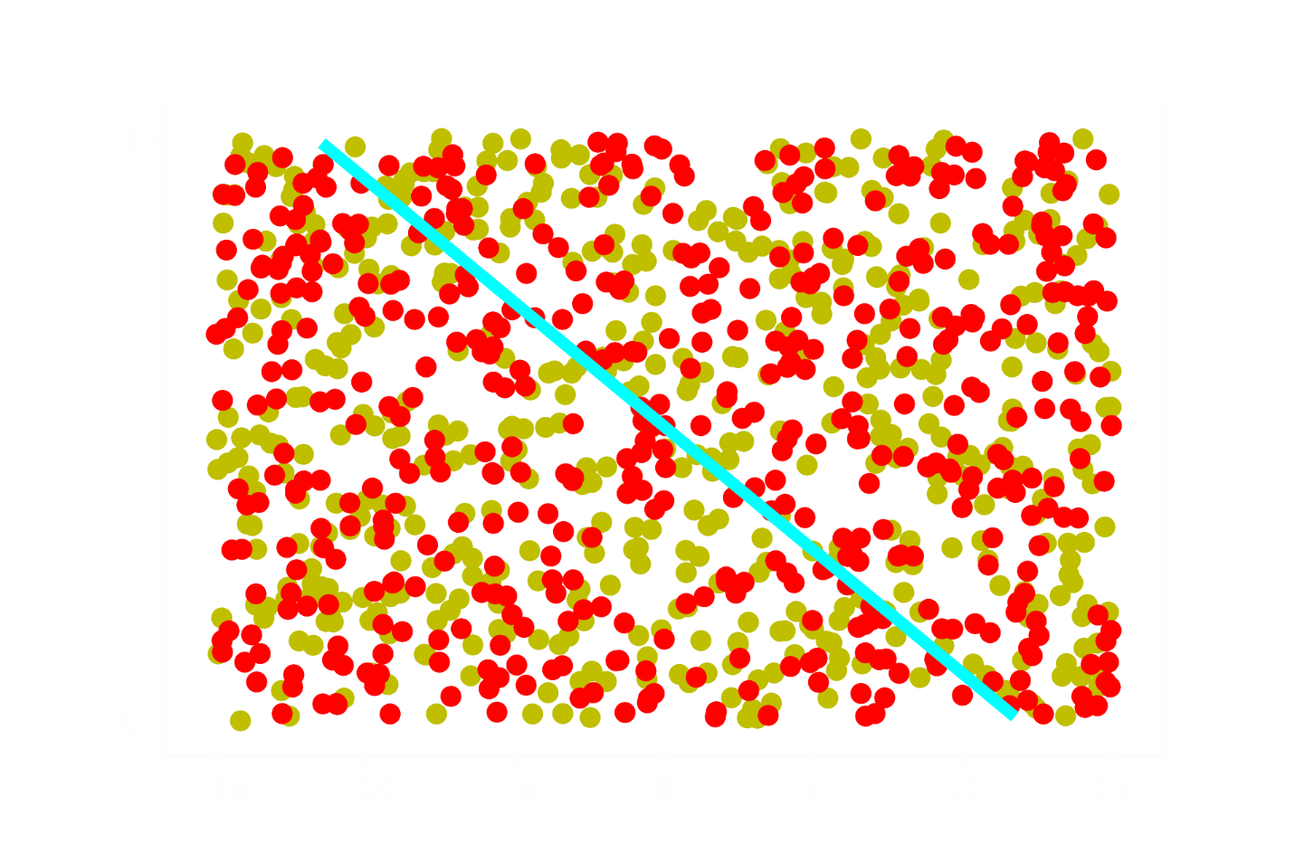
Regression-based performance
Predicting leave behavior: Logistic Regression
Example 1: Uniform Distribution of Prevalence and Magnitude
The observations generate the logistic regression.
Points on the cyan line represent individuals who the regression predicts a probability of exactly 0.5 of being “positive”.

Slide 127
Regression-based performance
Predicting leave behavior: Logistic Regression
Example 1: Uniform Distribution of Prevalence and Magnitude
Any individual with characteristics above the line are considered “positive”
Those below the line are “negative”

Slide 128
Regression-based performance
Predicting leave behavior: Logistic Regression
Example 1: Uniform Distribution of Prevalence and Magnitude
Suppose that this sample accurately represents the true population.
Select a random individual from the population to classify.

Slide 129
Regression-based performance
Predicting leave behavior: Logistic Regression
Example 1: Uniform Distribution of Prevalence and Magnitude
The probability that the regression classifies correctly is about 0.5.
This is no better than a coin flip!

Slide 130
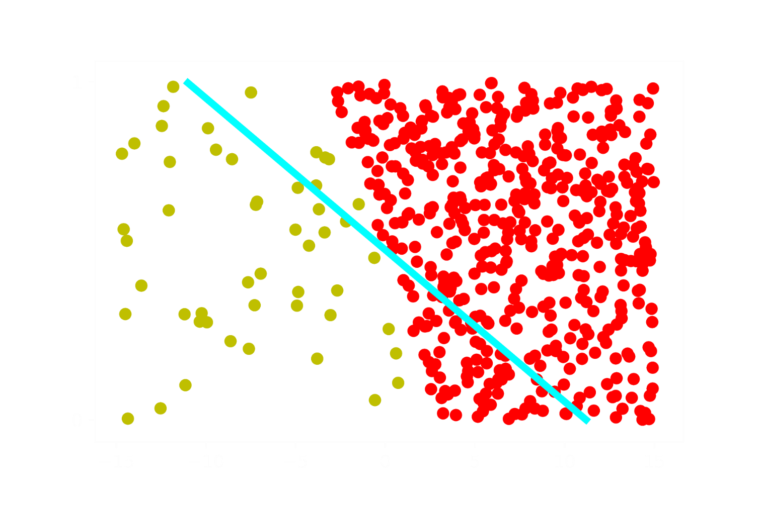
Regression-based performance
Predicting leave behavior: Logistic Regression
Example 2: Separated Distribution of Prevalence and Magnitude
As in example 1, the observations generate the logistic regression.
Points on the cyan line represent individuals who the regression predicts a probability of exactly 0.5 of being “positive”.

Slide 131
Regression-based performance
Predicting leave behavior: Logistic Regression
Example 2: Separated Distribution of Prevalence and Magnitude
Assume again that the sample observations give an accurate representation of the data.
We can thus see the above as four separate classes.

Slide 132
Regression-based performance
Predicting leave behavior: Logistic Regression
Example 2: Separated Distribution of Prevalence and Magnitude
We can thus see the above as four separate classes:
True Positive
True Negative
False Positive
False Negative
False Positive
True Positive
True Negative
False Negative

Slide 133
Regression-based performance
Predicting leave behavior: Logistic Regression
Example 2: Separated Distribution of Prevalence and Magnitude
Assume again that the sample observations give an accurate representation of the population.
Assume further that we select a random individual from the population.
False Positive
True Positive
True Negative
False Negative

Slide 134
Regression-based performance
Predicting leave behavior: Logistic Regression
Example 2: Separated Distribution of Prevalence and Magnitude
Due to prevalence, the probability of drawing an individual who is “positive” is significantly higher than “negative”.
False Positive
True Positive
True Negative
False Negative

Slide 135
Regression-based performance
Predicting leave behavior: Logistic Regression
Example 2: Separated Distribution of Prevalence and Magnitude
Due to magnitude, the probability that the individual is correctly classified will be quite high.
False Positive
True Positive
True Negative
False Negative

Slide 136
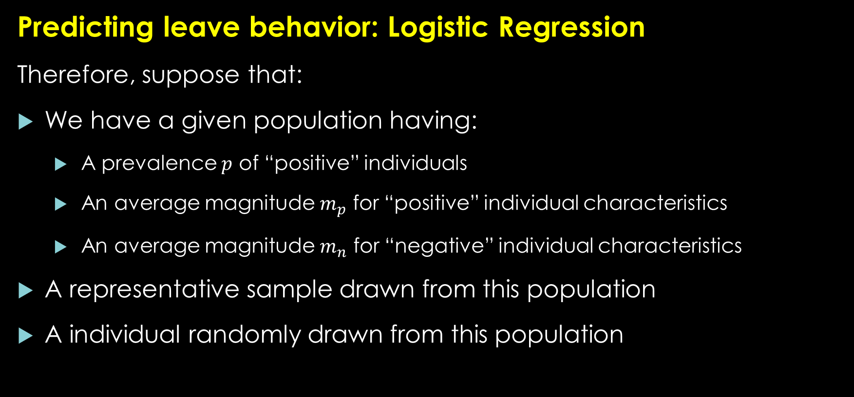
Regression-based performance
Predicting leave behavior: Logistic Regression
Therefore, suppose that:
We have a given population having:
A prevalence $p$ of “positive” individuals
An average magnitude $m_{p}$ for “positive” individual characteristics
An average magnitude $m_{n}$ for “negative” individual characteristics
A representative sample drawn from this population
A individual randomly drawn from this population

Slide 137
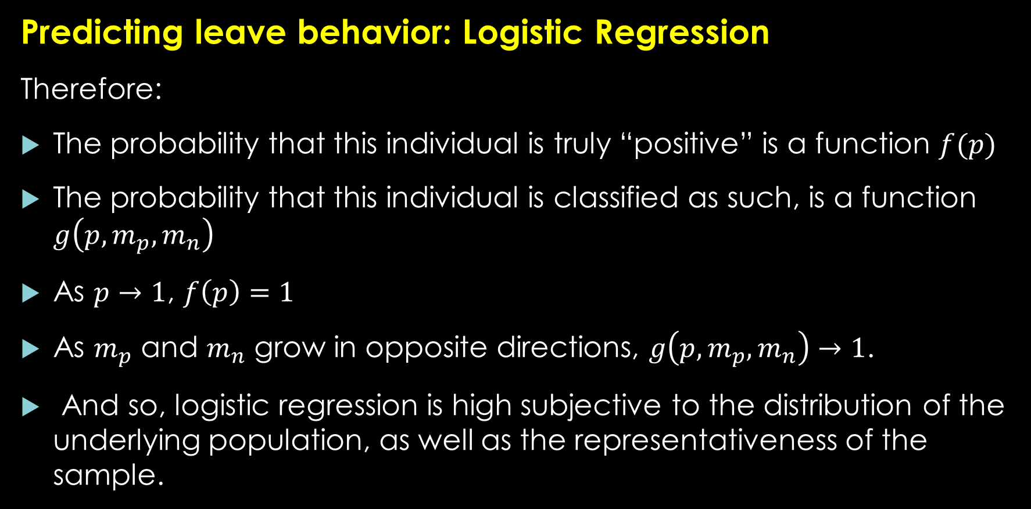
Regression-based performance
Predicting leave behavior: Logistic Regression
Therefore:
The probability that this individual is truly “positive” is a function $f(p)$
The probability that this individual is classified as such, is a function $g\left(p, m_{p},m_{n}\right)$
As $p→1$, $f\left(p\right)=1$
As $m_{p}$ and $m_{n}$ grow in opposite directions, $g\left(p, m_{p}, m_{n}\right)→1$.
And so, logistic regression is high subjective to the distribution of the underlying population, as well as the representativeness of the sample.

